Slide 1
Personal Assistant
CSC 520
Fall 2021
Presented by Brendan Geary
Notes:
Good morning everyone, my name is Brendan Geary and I will be presenting my project proposal of a Personal Assistant Application for CSC 520 today.

Slide 2
Student Objectives
To gain experience in the full lifecycle of software development.
To gain an understanding of Natural Language Processing
To learn the skill necessary to integrate various APIs within a singular product.
To gain hands on experience and skills with the Android based mobile application development.
Notes:
My personal goals with the completion of this project is to have gained more experience with the software development life cycle, from a project’s inception to its delivery. Along with this I also hope to better understand how Natural Language Processing is being utilized. Lastly I hope to be able to develop my ability to create Android-based mobile applications as well as have hone the ability to interweave multiple different API’s together.

Slide 3
Problem Specification
A Personal Assistant mobile application
Functionality:
Verbal commands input; “Set a timer”, “Create an alarm”, “Schedule a reminder”, etc.
Textual input
Text-to-Speech output with display
Notes:
The project itself is the development of a “Personal Assistant” application much like what already exists such as Siri or Bixby.
The assistant must have the ability to perform certain tasks when requested by the user through a verbal command
To increase accessibility with the application, users will also be able to manually input the required data for a task directly within an input screen through the app itself.
Once the assistant has accomplished the task, it will show the results of the task, be it a desired webpage, application, or notification, as well as inform the user through text-to-speech of the tasks’ completion.

Slide 4
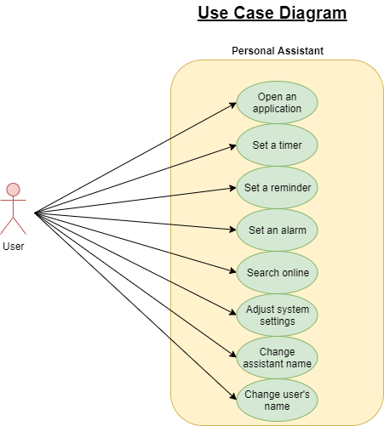
Solutions Process and Design
Use Case Diagram
Notes:
The preceding diagram shows the various actions that a user can accomplish while using the proposed application.
Currently 8 actions are planned to actionable in the final product.

Slide 5
Solutions Process and Design
Requirements Collection and Analysis
User | User Activities | Activities Related Features
User | User speaks phrase “ Create/make an alarm for y” | Assistant interfaces with the phone’s default alarm application
“” | User speaks phrase “Start/set a timer for y” | Assistant interfaces with the phone’s default timer application
“” | User speaks phrase “Create/set a reminder for y” | Assistant interfaces with the phone’s default calendar application
“” | User speaks a phrase in the form of a question | Assistant searches the internet using the phone’s default browser and displays the results
“” | User speaks phrase “Open/Start/run x” | Assistant searches the phone for the specified application and starts it
“” | User speaks phrase “Increase/decrease brightness” | Assistant adjusts the system’s settings to increase/decrease the brightness of the device
“” | User speaks phrase “Set/Change assistants’/users’ name to x” | Assistant changes the name it responds to in accordance with the given name
Notes:
This table shows how the various tasks a user can request will be handled by the program.
Each action will have its own general format for how the request should be made, with various ways to state it, and how each action is then accomplished. This will be done through the use of the Android development kits’ Intent class.
By creating an intent object, the Android operating system will search for and return any application capable of fulfilling the task issued to it by the program and by extension from the user themselves.

Slide 6
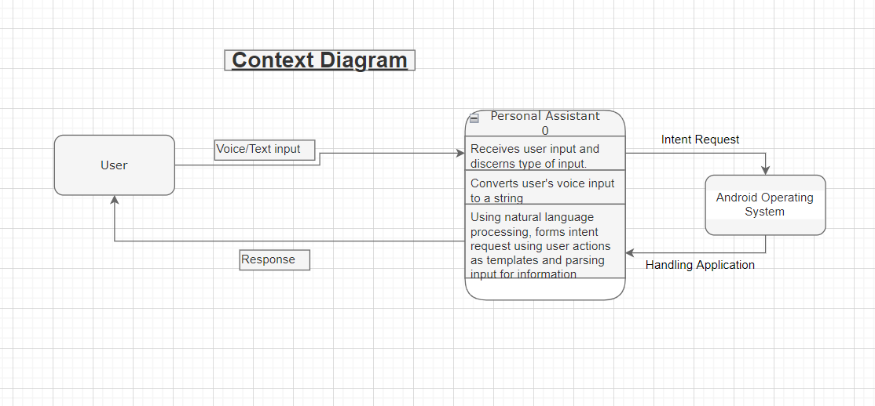
Solutions Process and Design
System Context Diagram
Notes:
This context diagram shows the way that necessary parts of the program interact with each other, the user will supply a form of textual or vocal input to the program, which would extrapolate the intended action, sending a request to the Android OS to which returns the handling application.

Slide 7
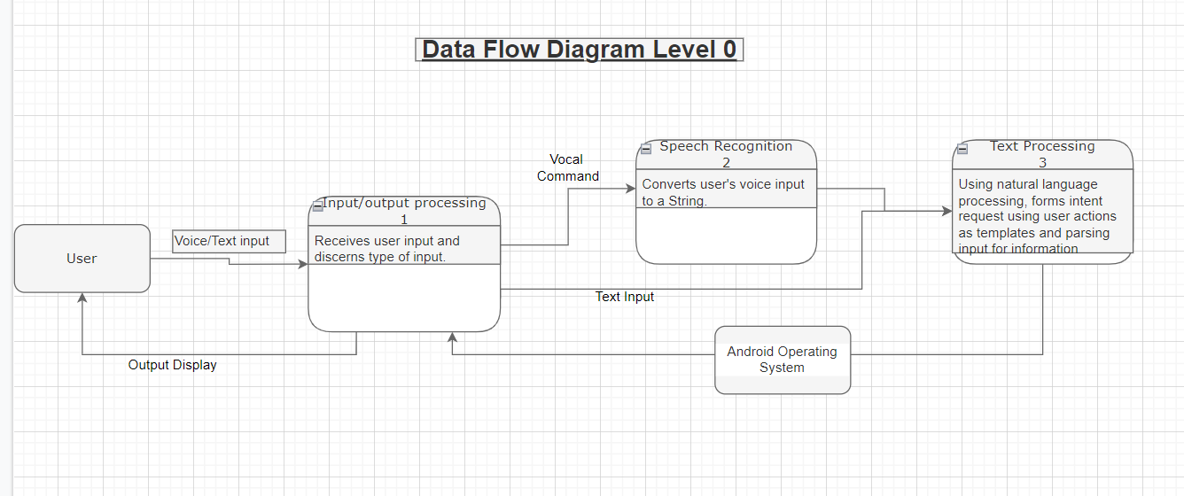
Solutions Process and Design
Data Flow Diagram Level 0
Notes:
At level 0, the diagram represents how data flows between the different sections of the program, these sections being Input/Output processing, Speech Recognition, and Text Processing. The Input/Output Processing handles receiving the input from the User as well as displaying the handler application returned by the operating system. The speech recognition section deals with the conversion of user voice commands to a stringified representation.

Slide 8
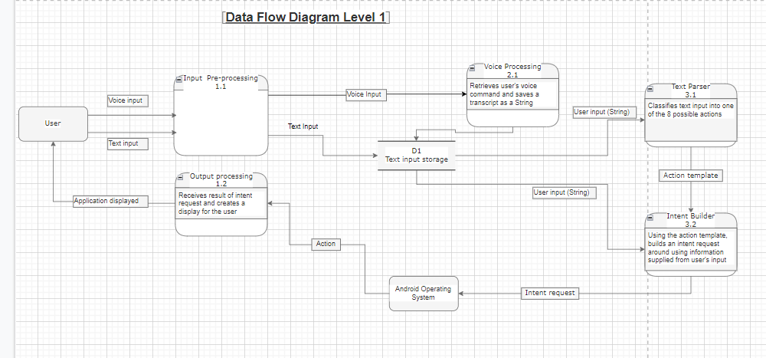
Solutions Process and Design
Data Flow Diagram Level 1
Notes:
Level 1 shows a more detailed breakdown of the sections, dividing the sections into separate functions which will be used to demonstrate the class’ layouts and the interactions between them.

Slide 9
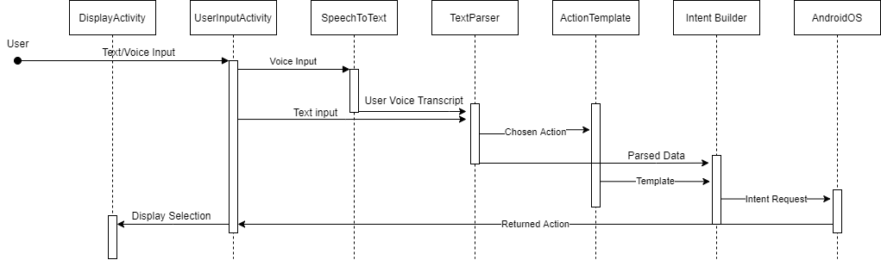
Solutions Process and Design
Sequence Diagram
Notes:
This diagram shows the order in which the program will call the various functions to perform a task. As well as this, it gives a basic overview of the type of information that will be shared between functions.

Slide 10
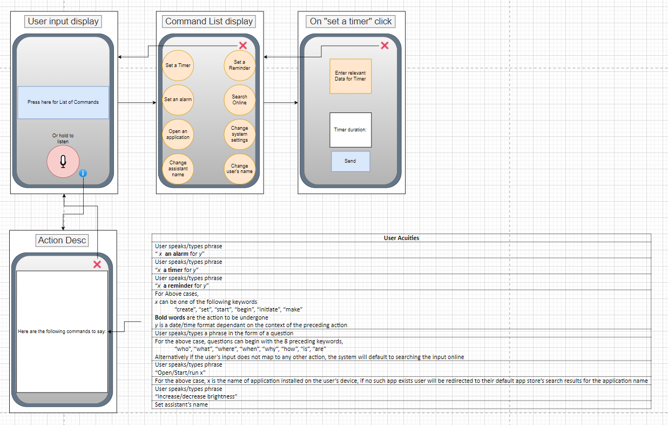
Solutions Process and Design
UI Mockups (1)
Notes:
The following diagrams show the layout that will be utilized by the program to convey information to the user.
The user input will allow for the user to either hold the microphone button to give verbal commands to the assistant
Alternatively offer submenus within the commands list to enter the required data for a specified task via text entry.
The small information button next to the microphone would then lead to a manual describing the various functionalities of the assistant and how to properly declare them.

Slide 11
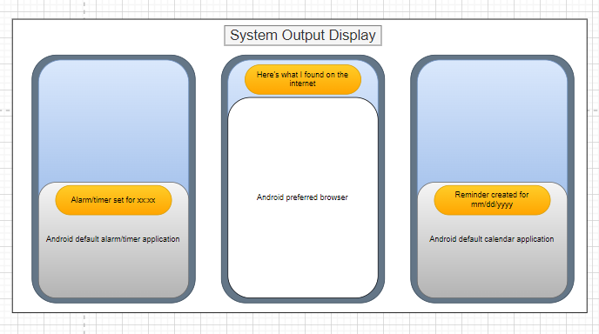
Solutions Process and Design
UI Mockups (1)
Notes:
The System Output Display section then shows the various types of resulting screens that may be displayed to the user upon successful completion of a task.

Slide 12
Agreement Form
Supervisor Selection for CSC 521
Notes:
Linked here is the faculty supervisor agreement form signed by myself and my faculty advisor Professor Brockenbrough.

Slide 13
Benchmark Specification (1)
Creation of the Application’s landing page
Creation of the GUI
Capable of accepting user’s text input
Capable of accepting user’s voice input
Saving of the above to temporary storage within the user’s device for logging
Implementation of Voice Processing Module
Capable of accessing the user’s voice input from the landing page and processing it into a String
Implementation of Text Processing Module
Capable of accessing the user’s text input from the Landing page’s temporary storage
Capable of accessing the user’s Stringified voice input from the Speech Processing Module’s temporary storage
Classify the input String according the possible actions
Notes:
In order to implement the Personal Assistant application, 6 benchmarks were created as follows with each benchmark following the previous in sequential order:
Firstly I will begin by creating the user interface seen previously in the UI mockups, capable of receiving the users’ verbal commands as well as being capable of taking textual input for accessibility
Next I will begin working on the voice processing module of the application, which will take the user’s verbal commands and transform it into a String object to be processed and evaluated later by the following module
The Text Processing Module will as previously said take the Stringified representation of the users’ command and evaluate it for the correct action to be undertaken.

Slide 14
Benchmark Specification (2)
5. Implementation of Intent Request Module
Capable of creating requests for Android OS to interpret
Capable of returning the application given by the Android OS
6. Implementation of Output Processing Module
Creation of individual output screens for the various user activities
Capable of displaying the screens with the information extracted from the user’s input
Integration Testing between modules between each benchmark
Notes:
Following the creation of the Text Processing Module, the Intent Request Module will then be developed. After the desired action is determined, the intent request module will parse the users’ command for the information necessary for crafting the Android Intent object. Determining durations, timeframes, and other key information.
Lastly the output display must be created to finish the project, with each possible user action having its’ own display screen as well as the assistant’s verbal feedback.
Between each completed benchmark I also plan on testing integration between each completed module to ensure that every module works correctly with every other module.

Slide 15
Tool List
In order to create the application, the following tools will be used during implementation; however it may not be representative of the final tool list after completion of the application.
Project Management Tool: Trello
https://trello.com/b/Ziynu6cy/geary-final-project-csc520-521
Source Control Tool: GitHub
solowraith/Personal-Assistant (github.com)
IDE:
Android Studio
Language:
Java
Python
Libraries:
GitHub - kartikn27/nlp-question-detection: Given a sentence, predict if the sentence is a question or not
GitHub - cmusphinx/sphinx4: Pure Java speech recognition library
15.ai: Natural TTS with minimal viable data
Notes:
In order to create the application, the following tools will be used during implementation; however it may not be representative of the final tool list after completion of the application.
The libraries chosen are as such to expedite the development of the assistant.
With the first being able to tell whether or not the users’ input is a question, which will be used for when the user wishes to search for something on the internet.
The next is a speech recognition library capable of taking the users’ verbal commands and translating them into text to later be processed by the application.
Lastly 15.ai is a Text-To-Speech module that will be utilized to allow the program to provide verbal feedback to the user.

Slide 16
Time Schedule
January
(January 02-15) Creation of UI landing page for receiving user’s request
(January 16-27) Creation of VoiceProcessing module to convert user’s voice to a String
(January 28-31) Integration testing of UI and VoiceProcessing
February
(February 01-21) Creation of TextProcessing module
(February 21-28) Creation of ActionTemplate module to provide a standardized way of assembling required data
(February 29-31)Integration testing of TextProcessing with the UI and voiceProcessing modules
Notes:
The following is a tentative schedule for the completion of the benchmarks in order to deliver the proposed application in a timely manner. Dates and times may be subject to change during actual development of the application.
Each benchmark should take roughly 2 weeks to complete depending on perceived complexity, with the longest allotted timespan being 3 weeks for the Text Processing module.
At the end of each modules’ creation I have allotted 3 days for integration testing to iron out any bugs found within the program during that time.

Slide 17
Time Schedule (2)
March
(March 01-18) Creation of IntentBuilder method which will construct an intent request using the user’s String and ActionTemplate’s template, receives activity from AndroidOS
(March 19-21) Integration testing of IntentBuilder and AndroidOS
(March 22- April 09) Creation of Output Processing module
April
(April 01-09) Add functionality to choose which display to show dependant on the intent request
(April 10-14) Integration testing of all modules combined
(April 15-30) Work on final presentation
May
(May 01-05) Practice project presentation
(May 05) Present project

Slide 18
Grading Scheme
UI Landing Page: | 10%
VoiceProcessing Module: | 20%
TextProcessing Module: | 25%
ActionTemplate: | 05%
IntentBuilder: | 10%
OutputDisplay Module: | 20%
Project Presentation: | 10%
Total: | 100%
Notes:
I propose that the following weighted grade distribution will be used for CSC521 which will be agreed upon with the faculty supervisor of the project.
Percentages were distributed according to time allotted and perceived difficulty of implementation of the benchmark.

Slide 19
Deliverables
Original proposal and presentation file(s) (from CSC 520)
Amendments to the proposal (approved by the CSC521 project supervisor)
System architecture diagram(s) (UML, DFD context, etc.), enhanced with details determined during implementation
Appropriately commented source code
Documentation of project functionality (test results, screenshots, video capture of project execution, etc.)
Sample output (screen shots and/or reports)
Executables and/or projects
Presentation documents (used to support the presentation of the completed CSC 521 project), including any presentation file(s)
Project journal: a narrative of the progress of the project, in clear, concise English, including any problems encountered and how said problems were addressed
Project postmortem: a summary of what was learned from the project and (based on that experience) discussion of how various aspects of the project might have been approached differently
A list of what areas of the proposal (if any) were not completed, including reasons why
Demonstration of the completed project (PowerPoint format), including screenshots of the functioning project
Notes:
Upon completion of the project, I plan on producing the following goals;

Slide 20
References
Cmusphinx. “CMUSPHINX/Sphinx4: Pure Java Speech Recognition Library.” GitHub, https://github.com/cmusphinx/sphinx4.
kartikn27. “Kartikn27/NLP-Question-Detection: Given a Sentence, Predict If the Sentence Is a Question or Not.” GitHub, https://github.com/kartikn27/nlp-question-detection.
“Natural TTS with Minimal Viable Data.” 15.Ai, https://finalfinaltest.15.ai/.
“Android Developers.” Android Developers, https://developer.android.com/.

